Slide 1

Exam DP-203: Data Engineering on Microsoft Azure Crash Course
Tim Warner

Slide 2


Tim Warner
Based in Nashville, TN, US
Central time zone
MCT, MVP
Twitter: @TechTrainerTim
Badge: TechTrainerTim.com

Slide 3
Day 1 of 2 Agenda
Introduction
Design and implement data storage (40-45%)
Design and implement data security (10-15%)
Exam DP-203 strategy

Slide 4
Day 2 of 2 Agenda
Content catch-up
Design and develop data processing
Monitor and optimize data
Exam DP-203 strategy

Slide 5
Course Materials
timw.info/dp203

Slide 6
A Different Kind of Training
We'll learn by doing – at least 80 percent demo
Visual, case study approach
10-minute break at midpoint
I’m here to answer your questions – take advantage of this!
Use the Q&A panel instead of group chat, please

Slide 7
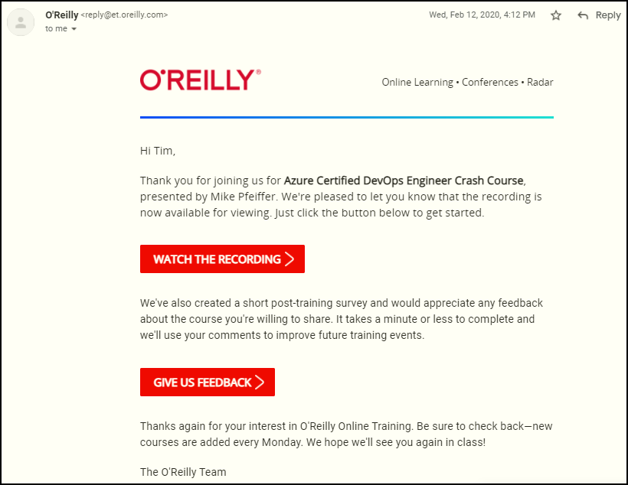
Session Recordings

Slide 8

Session Recordings

Slide 9

Session Recordings

Slide 10


Session Recordings

Slide 11


Data Engineer Cert Changes in 2021
August 31, 2021
DP-200
DP-201

Slide 12

Data Engineer Cert Changes in 2021
DP-203
DP-203
DP-203
Data Engineering on Microsoft Azure
Data Engineering on Microsoft Azure
1-year validity period

Slide 13
What is an Azure Data Engineer?
Design and implement the management, monitoring, security, and privacy of data using the full stack of data services
“Builds and tunes data pipelines”
“Implements, monitors, and optimizes data platforms”
“Has solid knowledge of SQL, Python, or Scala”
The Azure Data Scientist consumes the data the Engineer provides

Slide 14
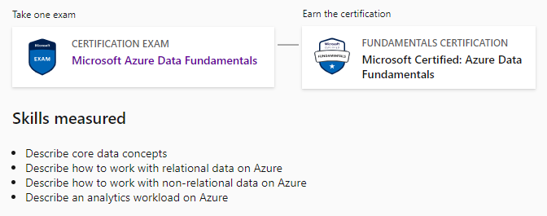
Azure Data Fundamentals
DP-900

Slide 15
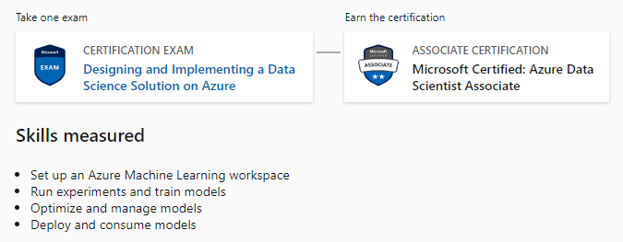
Azure Data Scientist Associate
DP-100

Slide 16
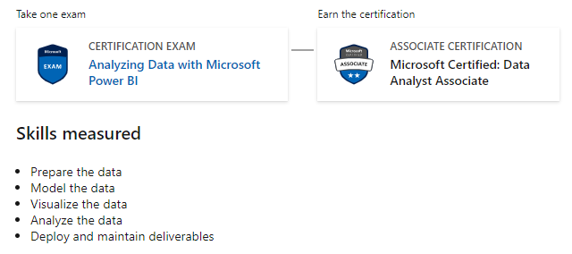
Azure Data Analyst Associate
DA-100

Slide 17

Tim's Certification Study Model
Content knowledge
Test-taking skills
Practical application

Slide 18
Thank you!
Course materials: timw.info/dp203
Twitter: @TechTrainerTim
Pluralsight: timw.info/ps
Web: timw.info

Slide 19
Exam DP-200 Item Types

Slide 20

Multiple Choice

Slide 21
Repeated Scenario
You need to move an Azure VM to another hardware host.
Solution: You redeploy the VM.
Does this solution meet the goal?
Yes
No

Slide 22

Select and Place

Slide 23

Build List and Reorder

Slide 24

Active Screen/Fill in the Blank

Slide 25

Case Study

Slide 26






Performance-Based Lab

Slide 27
Microsoft Online Testing

Slide 28
Microsoft Online Testing Process
timw.info/online

Slide 29
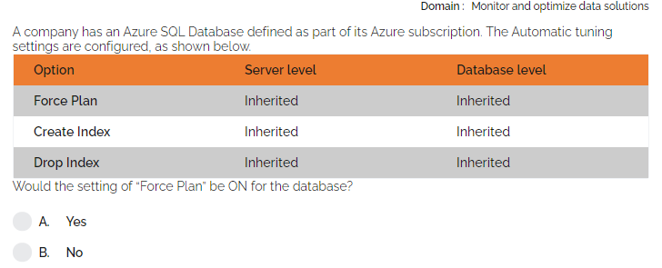

Slide 30
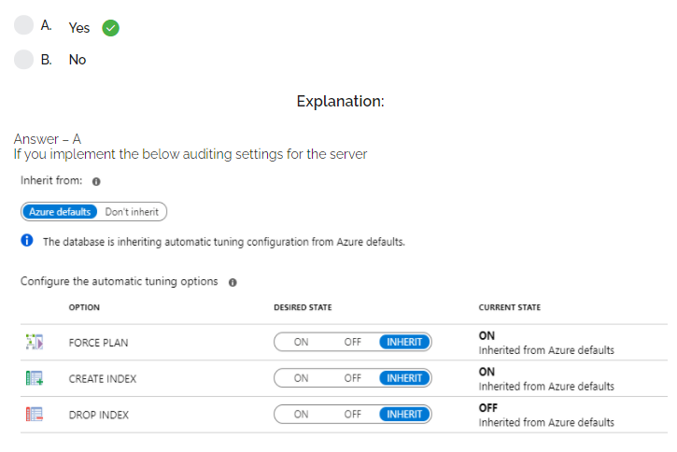

Slide 31
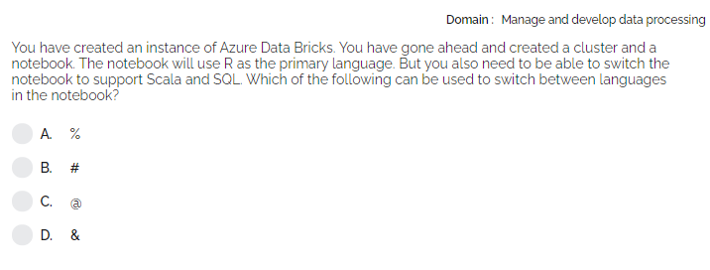

Slide 32
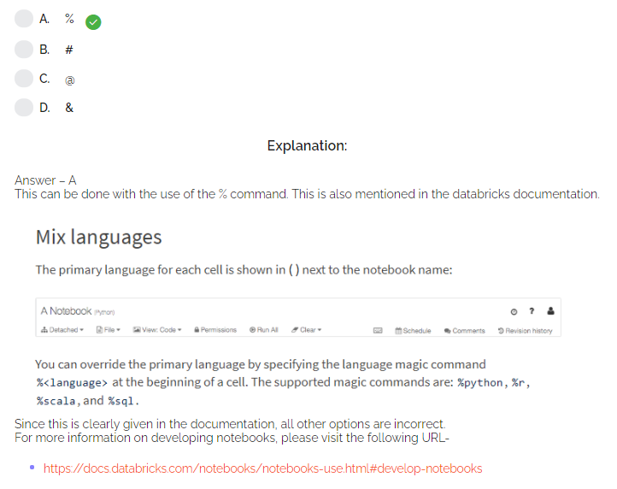

Slide 33
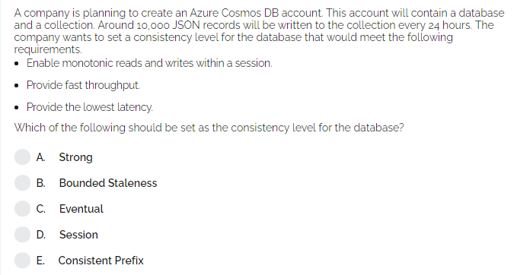

Slide 34
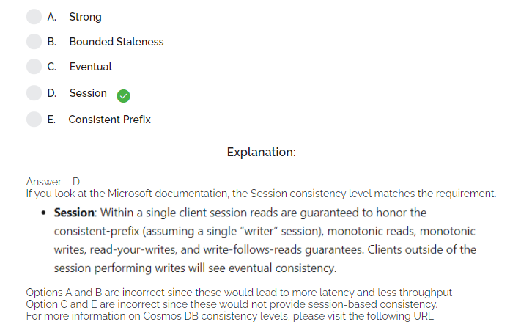

Slide 35
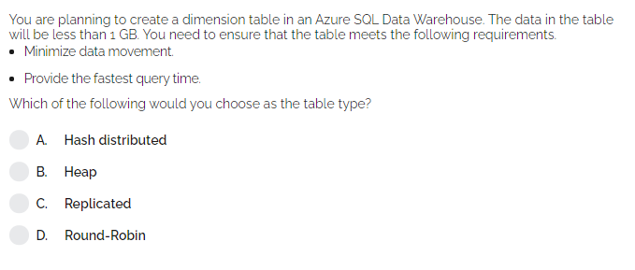

Slide 36
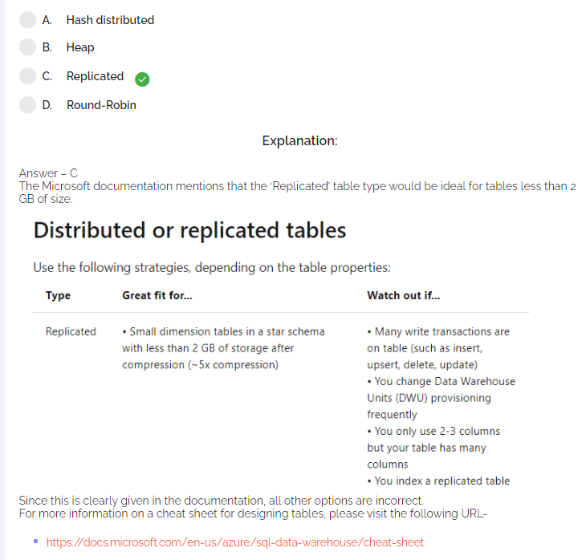

Slide 37
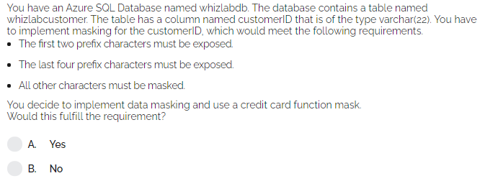

Slide 38
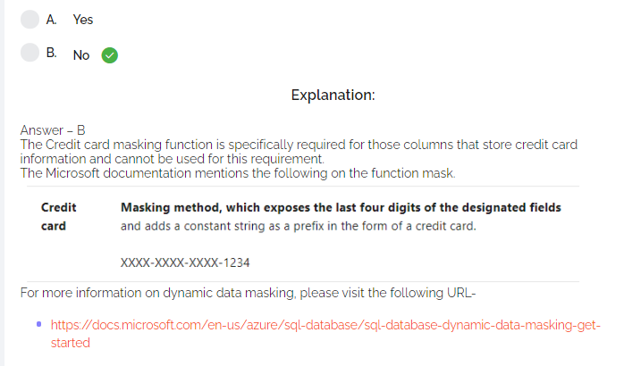

Slide 45
Core Data Concepts

Slide 46
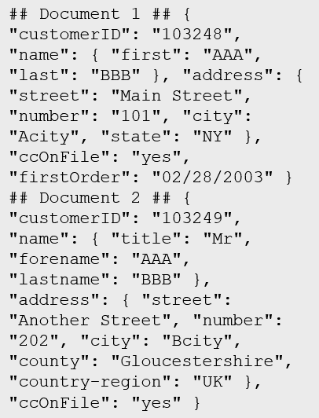
Data Types
Structured
Semi-structured
Unstructured
Table

Slide 47

Data Workload Types
Online Transactional Processing (OLTP)
Online Analytical Processing (OLAP)
Customer
CustomerID | CustomerName | CustomerPhone
Orders
OrderID | CustomerID | OrderDate
Data is periodically loaded, aggregated and stored in a cube
Data is stored one transaction at a time

Slide 48

Data Processing Types
Batch
Streaming

Slide 49





Data Analytics
On-premises data
SQL Server, Oracle, fileshares, SAP
Data ingestion
Data storage
Data processing
Data visualization
Cloud data
Azure, AWS, GCP
SaaS data
Salesforce, Dynamics

Slide 50
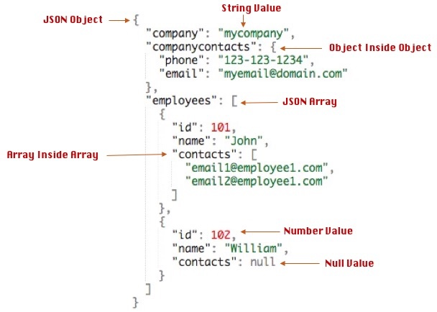
Data Formats - JSON

Slide 51
Query Tools
Azure Portal
Azure Storage Explorer
Azure Data Studio
Visual Studio Code
SQL Server Management Studio
PowerShell
Azure CLI
MySQL Workbench

Slide 52
Relational Data

Slide 53

Relational Database Use Cases
Identify relational database use cases
IoT:
Although typically considered for non-relational, the data from IoT devices could be structured and consistent
Online transaction processing:
For example order systems that perform many small transactional updates
Data warehousing:
Large amounts of data can be imported from multiple sources and structured to enable high-performance queries

Slide 54
Relational Database Tables
Customers
CustomerID | CustomerName | CustomerPhone
100 | Muisto Linna | XXX-XXX-XXXX
101 | Noam Maoz | XXX-XXX-XXXX
102 | Vanja Matkovic | XXX-XXX-XXXX
103 | Qamar Mounir | XXX-XXX-XXXX
104 | Zhenis Omar | XXX-XXX-XXXX
105 | Claude Paulet | XXX-XXX-XXXX
106 | Alex Pettersen | XXX-XXX-XXXX
107 | Francis Ribeiro | XXX-XXX-XXXX
Data is stored in a table
Table consists of rows and columns
All rows have same # of columns
Each column is defined by a datatype

Slide 55
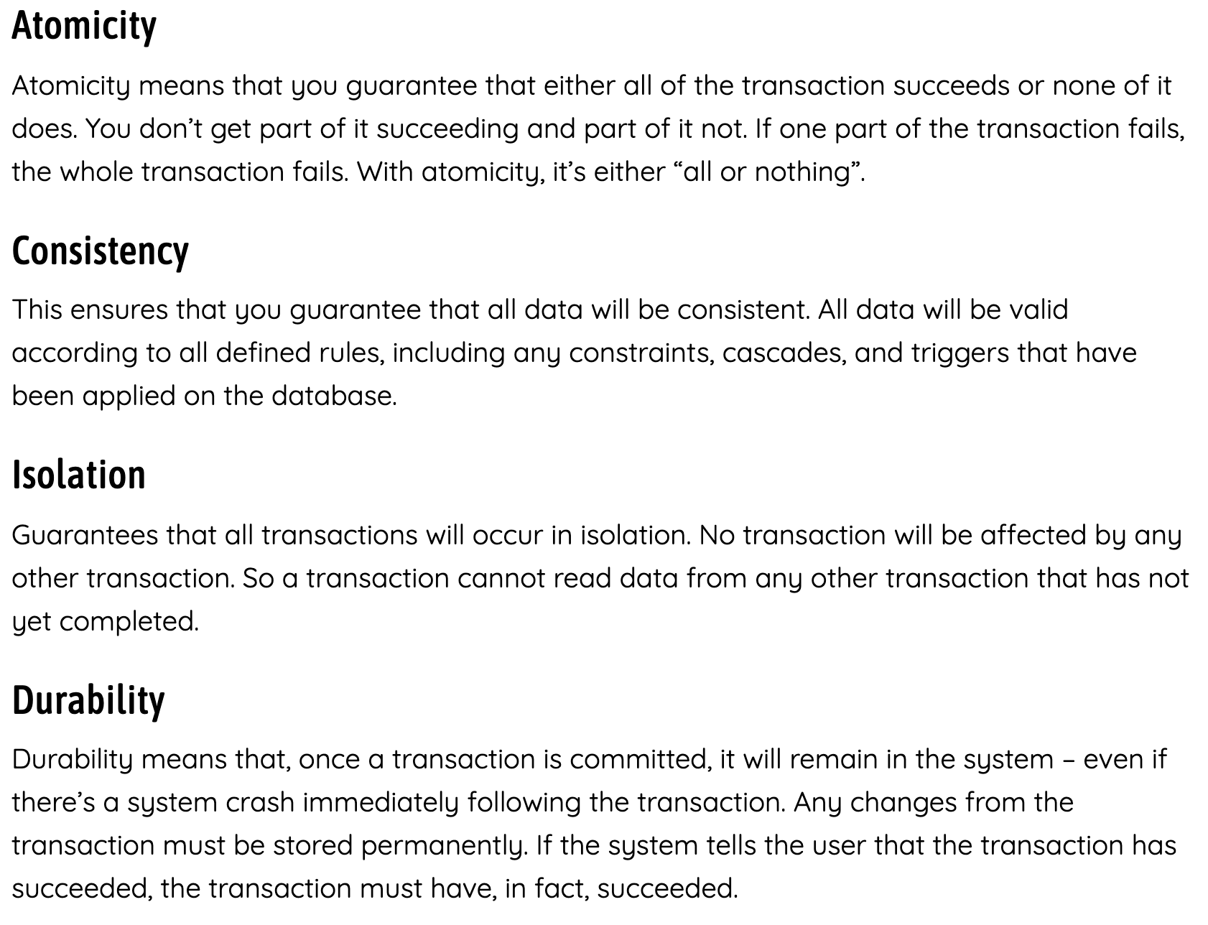
ACID Principle

Slide 56
Normalization
Customers
CustomerID | CustomerName | CustomerPhone
100 | Muisto Linna | XXX-XXX-XXXX
101 | Noam Maoz | XXX-XXX-XXXX
102 | Vanja Matkovic | XXX-XXX-XXXX
103 | Qamar Mounir | XXX-XXX-XXXX
104 | Zhenis Omar | XXX-XXX-XXXX
105 | Claude Paulet | XXX-XXX-XXXX
106 | Alex Pettersen | XXX-XXX-XXXX
Orders
OrderID | CustomerName | CustomerPhone
AD100 | Noam Maoz | XXX-XXX-XXXX
AD101 | Noam Maoz | XXX-XXX-XXXX
AD102 | Noam Maoz | XXX-XXX-XXXX
AX103 | Qamar Mounir | XXX-XXX-XXXX
AS104 | Qamar Mounir | XXX-XXX-XXXX
AR105 | Claude Paulet | XXX-XXX-XXXX
MK106 | Muisto Linna | XXX-XXX-XXXX
Data is normalized to:
Reduce storage
Avoid data duplication
Improve data quality

Slide 57

Table Relationships
Customers
CustomerID | CustomerName | CustomerPhone
100 | Muisto Linna | XXX-XXX-XXXX
101 | Noam Maoz | XXX-XXX-XXXX
102 | Vanja Matkovic | XXX-XXX-XXXX
103 | Qamar Mounir | XXX-XXX-XXXX
104 | Zhenis Omar | XXX-XXX-XXXX
105 | Claude Paulet | XXX-XXX-XXXX
106 | Alex Pettersen | XXX-XXX-XXXX
Orders
OrderID | CustomerID | SalesPersonID
AD100 | 101 | 200
AD101 | 101 | 200
AD102 | 101 | 200
AX103 | 103 | 201
AS104 | 103 | 201
AR105 | 105 | 200
MK106 | 105 | 201
In a normalized database schema:
Primary Keys and Foreign keys are used to define relationships
No data duplication exists (other than key values in 3rd Normal Form (3NF)
Data is retrieved by joining tables together in a query

Slide 58
Indexes
Customers
CustomerID | CustomerName | CustomerPhone
100 | Muisto Linna | XXX-XXX-XXXX
101 | Noam Maoz | XXX-XXX-XXXX
102 | Vanja Matkovic | XXX-XXX-XXXX
103 | Qamar Mounir | XXX-XXX-XXXX
104 | Zhenis Omar | XXX-XXX-XXXX
105 | Claude Paulet | XXX-XXX-XXXX
106 | Alex Pettersen | XXX-XXX-XXXX
IDX-CustomerRegion
CustomerID | Region
100 | France
101 | Brazil
102 | Croatia
103 | Jordan
104 | Spain
105 | France
106 | USA
An index:
Optimizes search queries for faster data retrieval
Reduces the amount of data pages that need to be read to retrieve the data in a SQL Statement
Data is retrieved by joining tables together in a query

Slide 59
Views
Customers
CustomerID | CustomerName | CustomerPhone
100 | Muisto Linna | XXX-XXX-XXXX
101 | Noam Maoz | XXX-XXX-XXXX
102 | Vanja Matkovic | XXX-XXX-XXXX
103 | Qamar Mounir | XXX-XXX-XXXX
104 | Zhenis Omar | XXX-XXX-XXXX
105 | Claude Paulet | XXX-XXX-XXXX
106 | Alex Pettersen | XXX-XXX-XXXX
Orders
OrderID | CustomerID | SalesPersonID
AD100 | 101 | 200
AD101 | 101 | 200
AD102 | 101 | 200
AX103 | 103 | 201
AS104 | 103 | 201
AR105 | 105 | 200
MK106 | 105 | 201
DB205 | 100 | 205
Create the definition of a view:
CREATE VIEW vw_customerorders AS
SELECT Customers.CustomerID, Customers.CustomerName, Orders.OrderID FROM Customers JOIN Orders on Customers.CustomerID = Orders.CustomerID
Retrieve the orders placed by customer 102 using the view:
SELECT CustomerName, OrderID from vw_customerorders WHERE CustomerID=102
A view is a virtual table based on the result set of query:
Views are created to simplify the query
Combine relational data into a single pane view

Slide 60
SQL Statement Categories
DML
DDL
DCL
Data Manipulation Language
Used to query and manipulate data
SELECT, INSERT, UPDATE, DELETE
Data Definition Language
Used to define database objects
CREATE, ALTER, DROP, RENAME
Data Control Language
Used to manage security permissions
GRANT, REVOKE, DENY

Slide 61
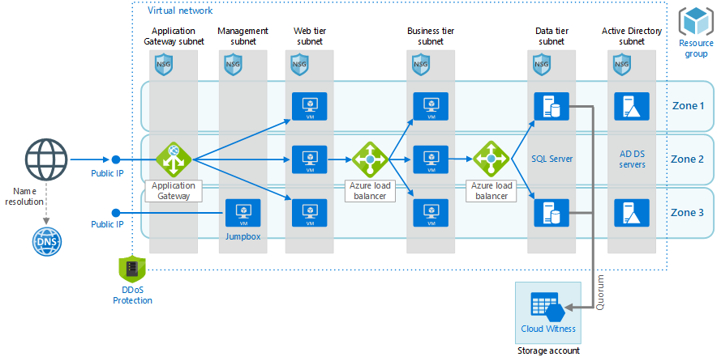
SQL Server in an Azure VM

Slide 62
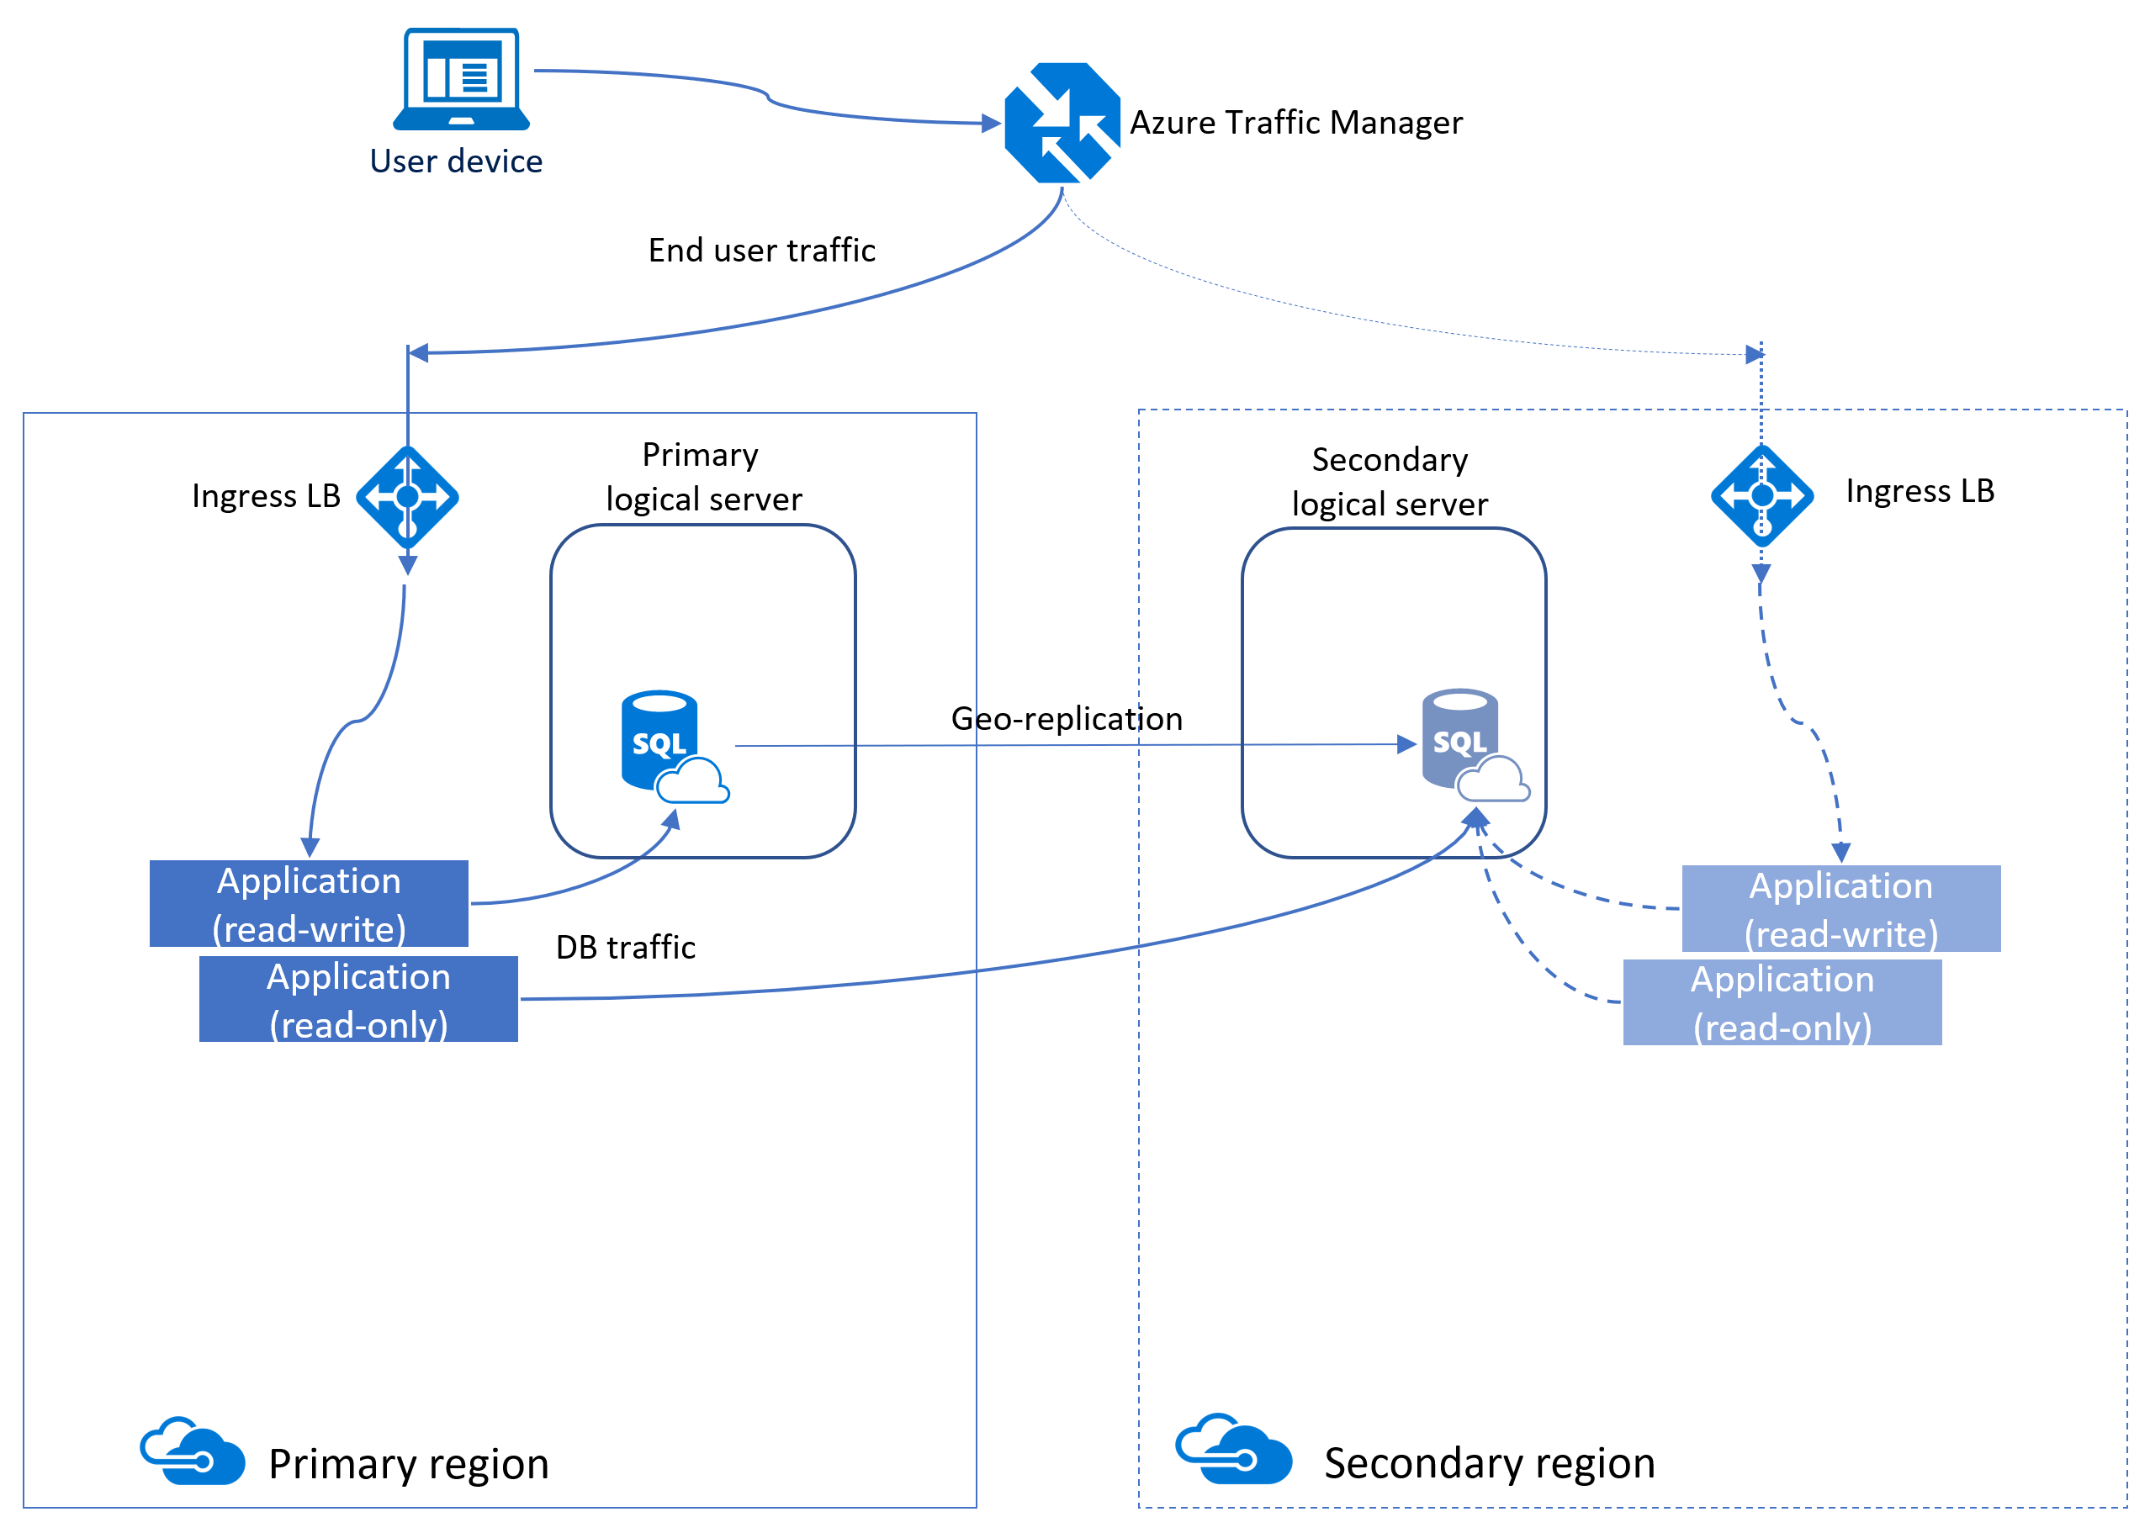
Azure SQL Database

Slide 63
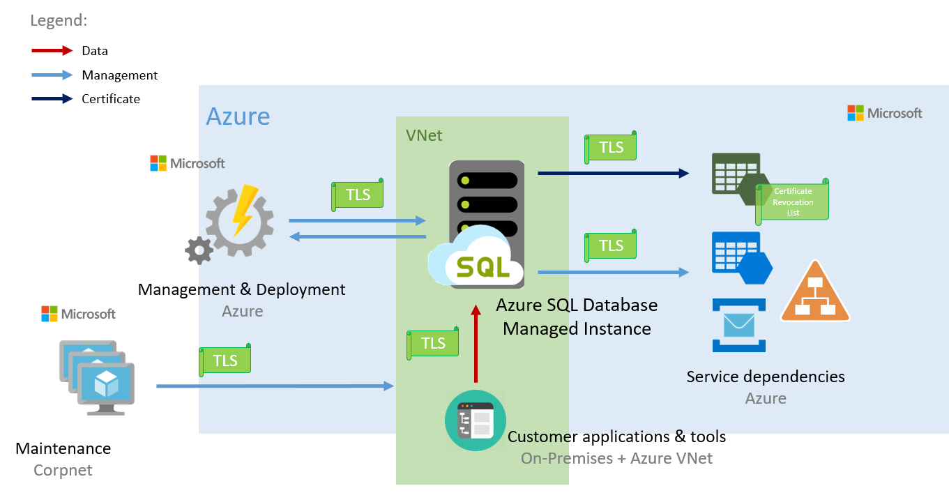
Azure SQL DB Managed Instance

Slide 64
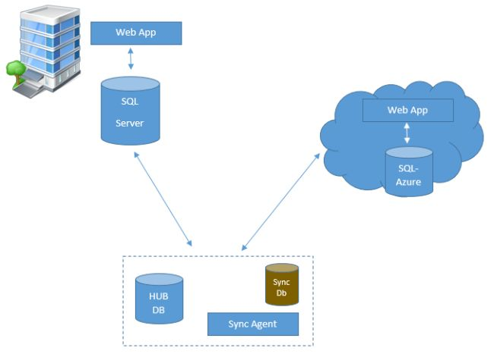
SQL Data Sync for Azure

Slide 65
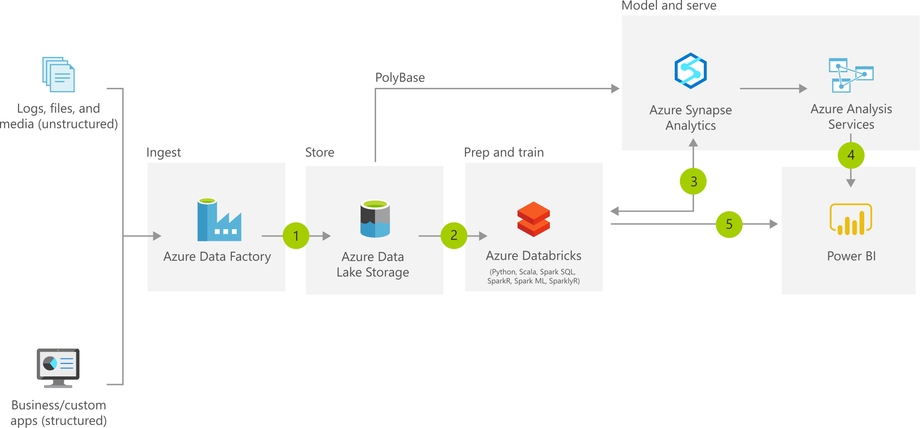
Azure Synapse

Slide 66
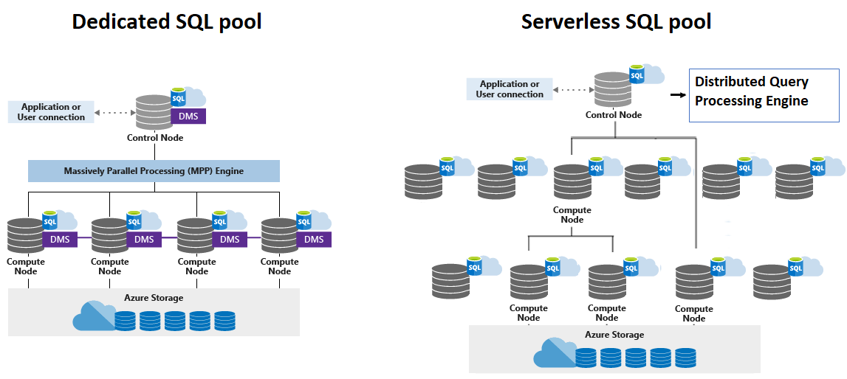
SQL Pool/Azure SQL Data Warehouse

Slide 67
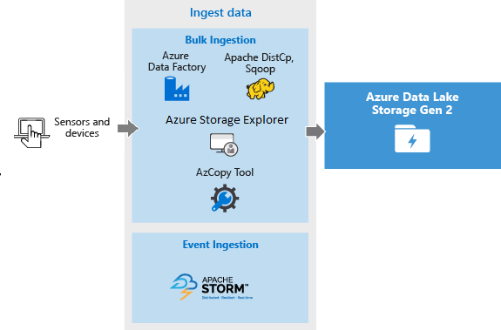
Azure Data Lake Storage Gen 2

Slide 68
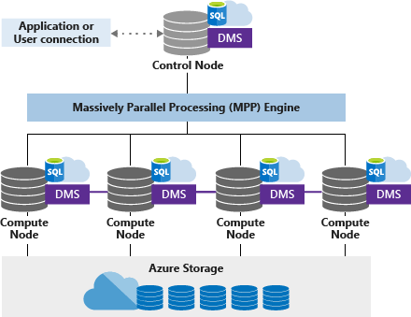
Azure Synapse SQL Pool (DW) Architecture

Slide 69
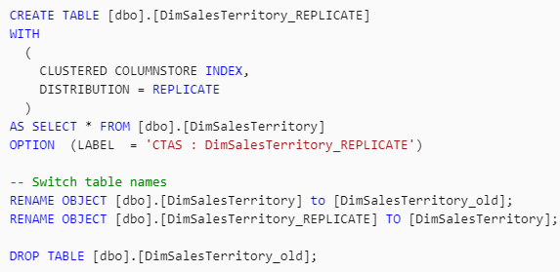
Azure Synapse Table Distribution Modes
https://timw.info/0jl

Slide 70
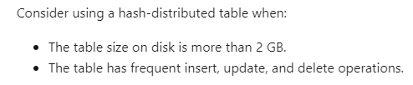
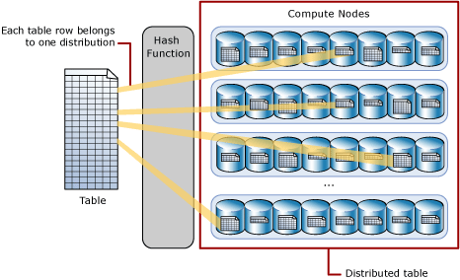
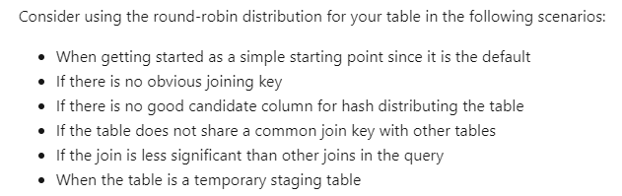
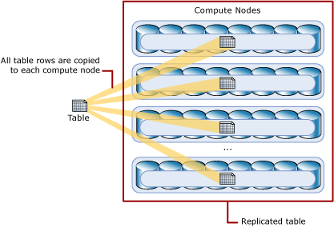
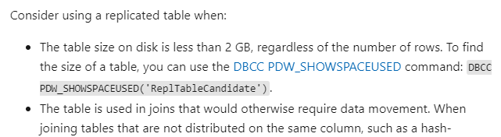
Azure Synapse Table Distribution Modes
https://timw.info/0jl

Slide 71
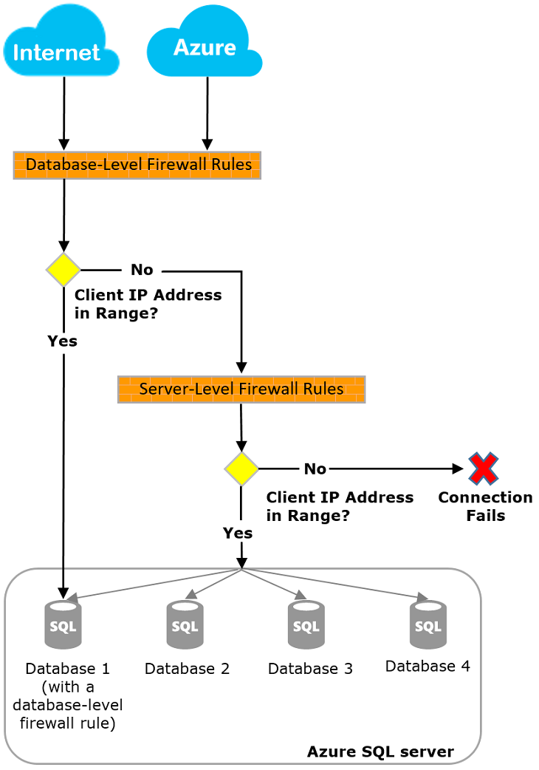
Azure SQL Database Firewall Rules

Slide 72
Non-Relational Data

Slide 73
Non-Relational Data Characteristics
## Customer 1 ID: 1
Name: Mark Hanson
Telephone: [ Home: 1-999-9999999, Business: 1-888-8888888, Cell: 1-777- 7777777 ]
Address: [ Home: 121 Main Street, Some City, NY, 10110,
Business: 87 Big Building, Some City, NY, 10111 ]
## Customer 2 ID: 2
Title: Mr
Name: Jeff Hay
Telephone: [ Home: 0044-1999-333333, Mobile: 0044-17545-444444 ]
Address: [ UK: 86 High Street, Some Town, A County, GL8888, UK,
US: 777 7th Street, Another City, CA, 90111 ]
Non-relational collections can have:
Multiple entities in the same collection or container with different fields
Have a different, non-tabular schema
Are often defined by labeling each field with the name it represents

Slide 74
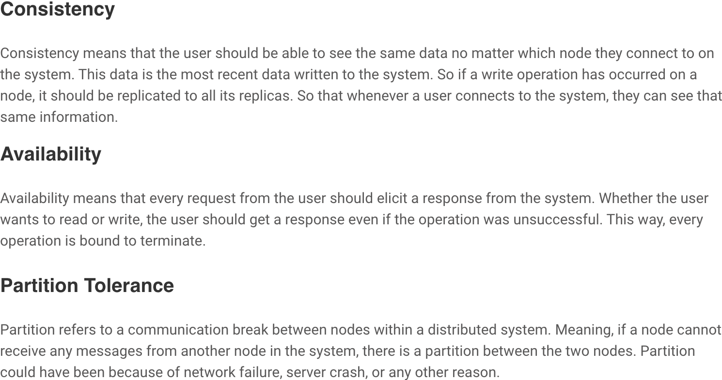
CAP Theorem

Slide 75
Azure Blob Storage
Block blobs
Page blobs
Append blobs
Has a maximum size of 4.7TB
Best for storing large, discrete, binary objects that changes infrequently
Each individual block can store up to 100MB of data
A block blob can contain up to 50000 blocks
Can hold up to 8TB of data
Is organized as a collection of fixed sized-512 byte pages
Used to implement virtual disk storage for virtual machines
The maximum size is just over 195GB
Is a block blob that is used to optimize append operations
Each individual block can store up to 4MB of data

Slide 76
Azure Table Storage
Key (Customer ID)
Value (Customer Data)
C1
AAAAA
BBB
101 Block Street
YY
999
888
C2
MM
NN
21 A Street
5 B Avenue
C3
DDD
EEE
FFF
111
222
66 C Road

Slide 77
Azure Cosmos DB
Scalability
Performance
Availability
Programming model

Slide 78
Cosmos DB APIs
SQL API
Table API
MongoDB API
Cassandra API
Gremlin API
Supports SQL-like query language
Compatible with Azure Table Storage
Compatible with MongoDB
Compatible with Cassandra
A graph database

Slide 79
Cosmos DB SQL API
COUNT( <fields_to_count> )
SUM( <numeric_fields> )
AVG( <numeric_fields> )
MAX( <numeric_fields> )
MIN( <numeric_fields> )
Aggregation Function Basics
SQL API examples
SELECT COUNT(*) FROM Products p
SELECT SUM(p.quantity) FROM Products p
WHERE p.expired = 0
SELECT AVG(p.price) AS ‘Average Price’
FROM Products p
SELECT p1.ID, p.Name, p1.Description, p1.Price FROM Products p1
WHERE p1.Price = (SELECT MIN(p2.Price) FROM Product p2)

Slide 80
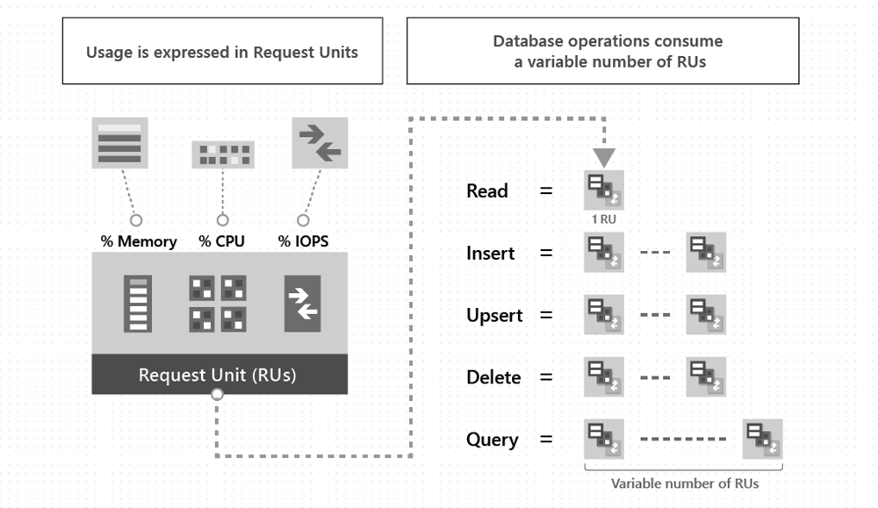
Request Units (RUs)

Slide 81
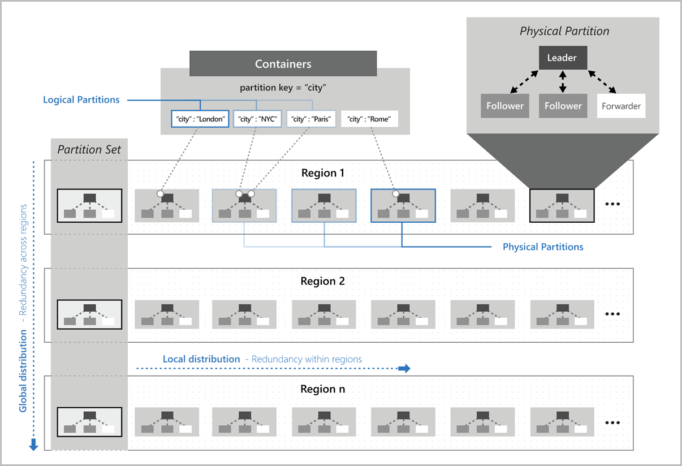
Cosmos DB Partitioning
Partition key:
* Value that doesn't change
* High cardinality
* SPs support ACID transactions

Slide 82
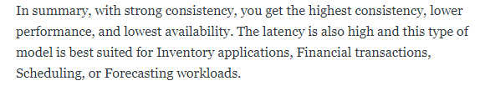
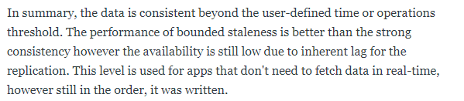

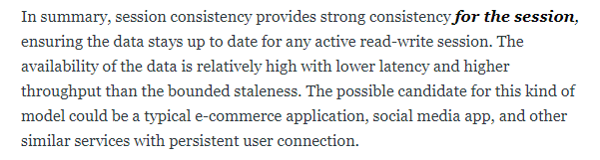
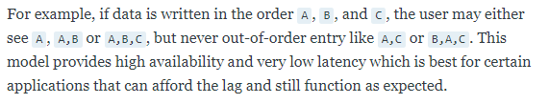
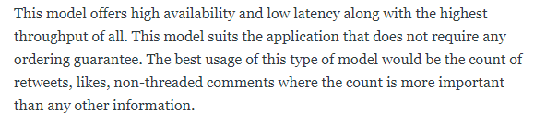
Consistency Levels
Strong
Bounded Staleness
Session
Consistent Prefix
Eventual
https://timw.info/fhq

Slide 83
Cosmos DB Consistency Levels Take 2

Slide 84
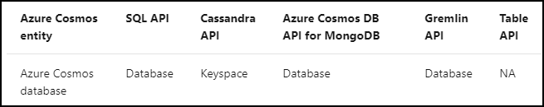
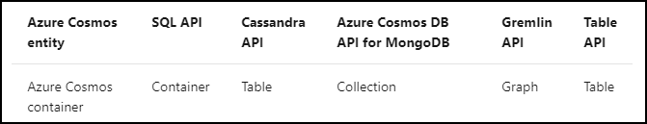
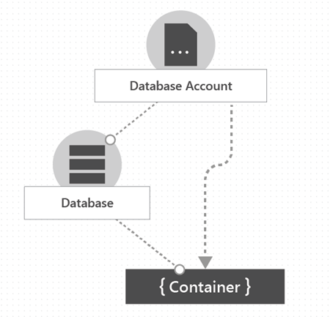
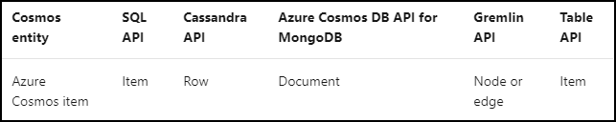
Cosmos DB Resource Model
Database
Container
Item
https://timw.info/ft6

Slide 85
Data Analytics

Slide 86
Data Processing

Slide 87
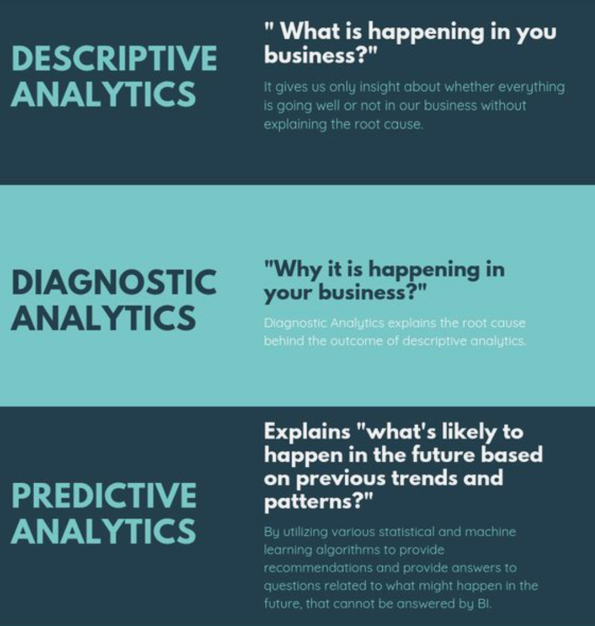
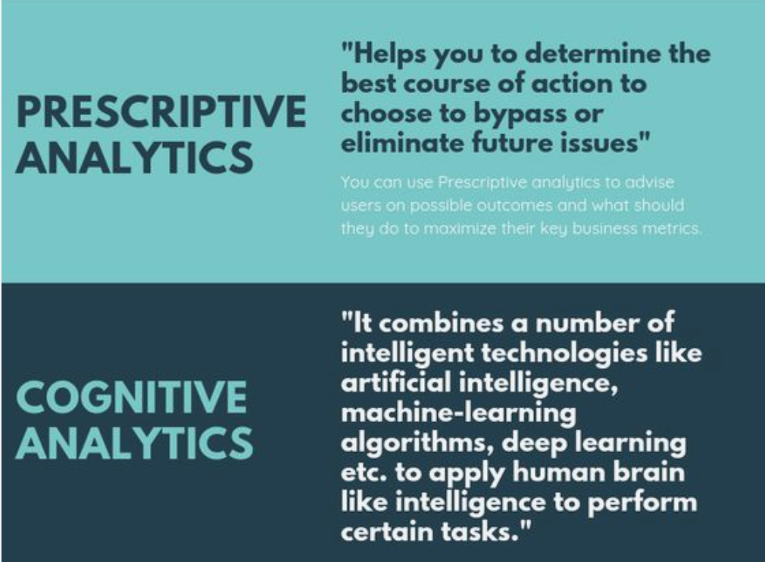
Data Analytics - Types

Slide 88
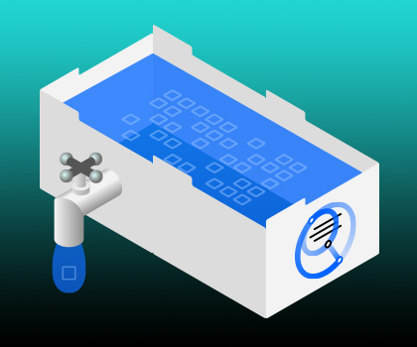
Data Lake

Slide 89
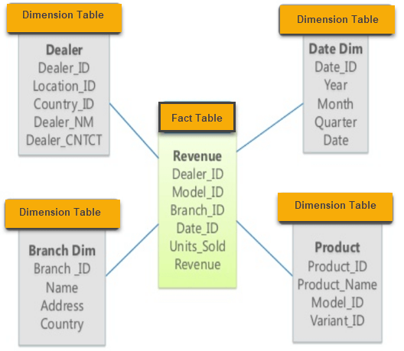
Data Warehouse Star Schema

Slide 90
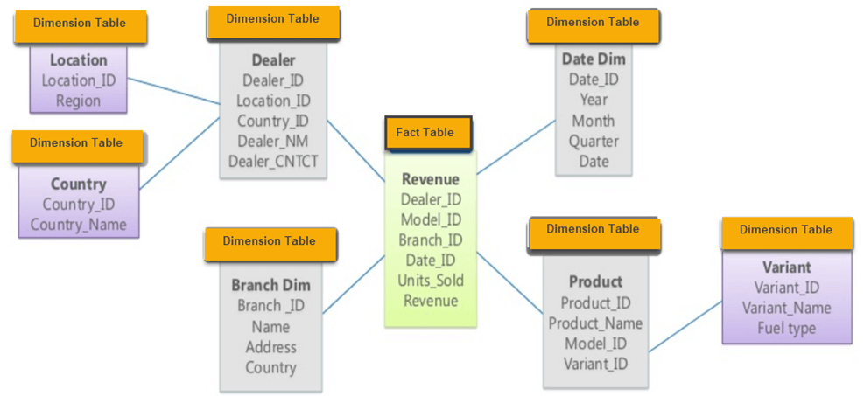
Data Warehouse Snowflake Schema

Slide 91
ETL
Azure Data Factory
Azure Stream Analytics

Slide 92
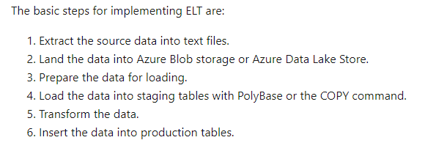
ELT

Slide 93

Azure Synapse
PolyBase

Slide 94

ADLS Gen 2
A repository of data for your Modern Data Warehouse
Organises data into directories for improved file access
Supports POSIX and RBAC permissions
It is compatible with Hadoop Distributed File System
Store
Azure Data Lake Storage
High performance data lake available in all 54 Azure regions

Slide 95

Azure Databricks

Slide 96

Azure Data Factory

Slide 97

Power BI

Slide 98
Data engineering job responsibilities
New skills for new platforms
Changing loading approaches
From implementing to provisioning
Notes:
Instructor notes
This slide outlines the three core areas that Data Engineers will be responsible for. First is a responsibility to learn new skills for the new platforms. This may mean understanding new data storage paradigms such as No-SQL solutions, or streaming data solutions. It will also likely involve learning new languages depending on the technologies that are provisioned.
Data Engineers will also have to be open to the idea that data loading techniques that were appropriate for on-premises scenarios, may not necessarily work for processing data within the cloud. More details will follow as they go through the course.
Students should also understand that with the move from on-premises to the cloud, they will move from a place of physically implementing machines and services, to provisioning them either using the Azure portal, or likely be creating code that can be used to quickly deploy services with minimal errors. Azure Administrators refer to this as infrastructure as code

Slide 99
Structured versus Unstructured data
There are three broad types of data and Microsoft Azure provides many data platform technologies to meet the needs of the wide varieties of data
Structured
Semi-Structured
Unstructured
Structured data is data that adheres to a schema, so all of the data has the same fields or properties. Structured data can be stored in a database table with rows and columns
Semi-structured data doesn’t fit neatly into tables, rows, and columns known as No-SQL., there are four types of No-SQL databases:
Key Value Store
Document Database
Graph Databases
Column Base
Unstructured data encompasses data that has no designated structure to it. It includes files such as PDF and word documents, video and sound files as examples
Notes:
Instructor notes
Before going through the various data platform technologies that are available in Azure, make sure that the students do know the difference between structured versus unstructured data

Slide 100





What to use for Data
When you need a low cost, high throughput data store
When you need to store No-SQL data
When you do not need to query the data directly. No ad hoc query support
Suits the storage of archive or relatively static data
Suits acting as a HDInsight Hadoop data store
Module 02
Storage Account
When you need a low cost, high throughput data store
Unlimited storage for No-SQL data
When you do not need to query the data directly. No ad hoc query support
Suits the storage of archive or relatively static data
Suits acting as a Databricks , HDInsight and IoT data store
Module 02
Data Lake Store
Eases the deployment of a Spark based cluster
Enables the fastest processing of Machine Learning solutions
Enables collaboration between data engineers and data scientists
Provides tight enterprise security integration with Azure Active Directory
Integration with other Azure Services and Power BI
Module 03
Azure Databricks
Provides global distribution for both structured and unstructured data stores
Millisecond query response time
99.999% availability of data
Worldwide elastic scale of both the storage and throughput
Multiple consistency levels to control data integrity with concurrency
Module 04
Azure CosmosDB
When you require a relational data store
When you need to manage transactional workloads
When you need to manage a high volume on inserts and reads
When you need a service that requires high concurrency
When you require a solution that can scale elastically
Module 05
Azure SQL Database
Notes:
Instructor notes
Note: This is a build slide for multiple topics by design.
It is important to stress to the students that this is an overview of the data platform capability, as a result multiple topics are on a single slide to aid in brevity.
The important point to note with this slide are the 5 bullet points next to each technology

Slide 101





What to use for Data
When you require an integrated relational and big data store
When you need to manage data warehouse and analytical workloads
When you need low cost storage
When you require the ability to pause and restart the compute
When you require a solution that can scale elastically
Module 05
Azure Synapse
Analytics
When you require a fully managed event processing engine
When you require temporal analysis of streaming data
Support for analyzing IoT streaming data
Support for analyzing application data through Event Hubs
Ease of use with a Stream Analytics Query Language
Module 06
Azure Stream Analytics
When you want to orchestrate the batch movement of data
When you want to connect to wide range of data platforms
When you want to transform or enrich the data in movement
When you want to integrate with SSIS packages
Enables verbose logging of data processing activities
Module 07
Azure Data Factory
When you need a low cost, high throughput data store
When you need to store No-SQL data
Provides a Hadoop Platform as a Service approach
Suits acting as a Hadoop, Hbase, Storm or Kafka data store
Eases the deployment and management of clusters
Azure HDInsight
When you require documentation of your data stores
When you require a multi user approach to documentation
When you need to annotate data sources with descriptive metadata
A fully managed cloud service whose users can discover the data sources
When you require a solution that can help business users understand their data
Azure Data Catalog
Notes:
Instructor notes
Note: This is a build slide for multiple topics by design.
It is important to stress to the students that this is an overview of the data platform capability, as a result multiple topics are on a single slide to aid in brevity.
The important point to note with this slide are the 5 bullet points next to each technology
HDIsight is not covered on this course as there are other courses that cover this. Azure Data Catalog is not on this course as it is not part of the exam objectives and it is a easy technology to learn.

Slide 102
Compare Azure Blob Storage and Data Lake Store Gen 2
Azure Blob
Flat namespace
Data Lake (Gen II)
Hierarchical namespace
Notes:
Instructor notes
The black dot represents the root or parent folder in the hierarchy, and blue dots represent different type of data. It is a conceptual image and not meant to be specific. The key point to take away is that there is only one level in a flat namespace, a multiple hierarchy in a hierarchical namespace. This enables the quick traversal of data that suits big data analytics

Slide 103

Create a Azure Data Lake Store (Gen II) using PowerShell
Notes:
Instructor notes
Consider demonstrating PowerShell in the cloud shell in the Azure Portal.

Slide 104

Uploading data with Azure Storage Explorer
Notes:
Instructor notes
Consider demonstrating Microsoft Azure Storage Explorer to upload a file into a data lake store

Slide 105

Copy data from an Azure Data Lake Store Gen1 to an Azure Data Lake Store Gen2
Notes:
Instructor notes
Many Azure data platform technologies recommend that Azure Data Lake Storage Account Gen2 is used as a storage layer for big data analytical scenarios. Some of your customers may already be using Azure Data Lake Storage Account Gen1. This slide enables you to explain that Azure Data Factory has a wizard that eases the migration of data from Azure Data Lake Storage Account Gen1 to Azure Data Lake Storage Account Gen2.
It is not recommended that you do not demonstrate this at this stage as it will potentially cause a lot of questions. Inform the students that there is a separate module on Azure Data Factory in Module 7.

Slide 106
What is Azure Databricks
Apache Spark-based analytics platform:
Simplifies the provisioning and collaboration of Apache Spark-based analytical solutions
Enterprise Security:
Utilizes the security capabilities of Azure
Integration with other Cloud Services:
Can integrate with a variety of Azure data platform services and Power BI
Notes:
Instructor notes
Many students are confused between the difference between Hadoop and Spark.
As background, read this excellent article from data science central for in depth background information. You may not go into so much depth with the students, but it is very useful to know
https://www.datasciencecentral.com/profiles/blogs/what-is-the-difference-between-hadoop-and-spark.
From a security perspective, there is strong integration with Active Directory as well as having the capability of fine grain controlled permissions
https://docs.microsoft.com/en-us/azure/databricks/security/
In this module, the students will see how Azure Databricks integrates with Azure Data Lake, but it is important to stress that it does integrate with other technologies as well including Azure Data Factory and Azure Synapse Analytics.

Slide 107
What is Apache Spark
Apache Spark emerged to provide a parallel processing framework that supports in-memory processing to boost the performance of big-data analytical applications on massive volumes of data
Why use Azure Databricks?
Azure Databricks is a wrapper around Apache Spark that simplifies the provisioning and configuration of a Spark cluster in a GUI interface
Interactive Data Analysis:
Used by business analysts or data engineers to analyze and prepare data
Streaming Analytics:
Ingest data from technologies such as Kafka and Flume to ingest data in real-time
Machine Learning:
Contains a number of libraries that enables a Data Scientist to perform Machine Learning
Azure Databricks components:
Spark SQL and DataFrames
Streaming
Mlib
GraphX
Spark Core API
Notes:
Instructor notes
While this slide highlight the three key uses of Azure Databricks, its key selling point is that it is a one-stop shop for enabling Data Engineering and Data Science collaboration through a simplified environment that helps these roles to ingest, store, prep and train, and model and serve data science projects

Slide 108
Reading data in Azure Databricks
SQL | DataFrame (Python)
SELECT col_1 FROM myTable | df.select(col("col_1"))
DESCRIBE myTable | df.printSchema()
SELECT * FROM myTable WHERE col_1 > 0 | df.filter(col("col_1") > 0)
..GROUP BY col_2 | ..groupBy(col("col_2"))
..ORDER BY col_2 | ..orderBy(col("col_2"))
..WHERE year(col_3) > 1990 | ..filter(year(col("col_3")) > 1990)
SELECT * FROM myTable LIMIT 10 | df.limit(10)
display(myTable) (text format) | df.show()
display(myTable) (html format) | display(df)
Notes:
Instructor notes
This slide is intended to show similes between the SQL language with the Python language. Both of which can be used in Azure Databricks

Slide 109
Performing ETL to populate a data model
The goal of transformation in Extract Transform Load (ETL) is to transform raw data to populate a data model
Extraction
Data validation
Transformation
Corrupt record handling
Loading data
Connect to many data stores:
Postgres
SQL Server
Cassandra
Cosmos DB
CSV, Parquet
Many more..
Validate that the data is what you expect
Applying structure and schema to your data to transform it into the desired format
Built-in functions of Databricks allow you to handle corrupt data such as missing and incomplete information
Highly effective design pattern involves loading structured data back to DBFS as a parquet file
Notes:
Instructor notes
The goals of transformation will likely be familiar to many of your students on the course, so the categories listed in the slide will be familiar to them. It is worth outlining that some of this work may be done in different ways. As an example, state that the best practice to loading data into Azure Synapse Analytics would be performed using PolyBase from source files, rather than SSIS packages.

Slide 110

Create an Azure Cosmos DB account
Notes:
Instructor notes
You can either use this screenshot to go through the settings for Azure Cosmos DB, alternatively, log into the Azure portal to see the latest GUI version. Use this to drive the conversation around the Azure Cosmos DB settings.

Slide 111
What are Request Units
Throughput is important to ensure you can handle the volume of transactions you need
Database throughput
Database throughput is the number of reads and writes that your database can perform in a single second
What is a Request Unit
Azure Cosmos DB measures throughput using something called a request unit (RU). Request unit usage is measured per second, so the unit of measure is request units per second (RU/s). You must reserve the number of RU/s you want Azure Cosmos DB to provision in advance
Exceeding throughput limits
If you don’t reserve enough request units, and you attempt to read or write more data than your provisioned throughput allows, your request will be rate-limited
Notes:
Instructor notes
As well as focusing on the specific details of Request Units (RTU) as per the student manual, mention to the student that from an exam perspective they should be able to understand the difference between RTU’s, DTU’s and DWU’s and the technologies to which they map to.

Slide 112
Choosing a Partition Key
Why have a Partition Strategy?
Having a partition strategy ensures that when your database needs to grow, it can do so easily and continue to perform efficient queries and transactions
Best practice
Range of values:
The more values your partition key has, the more scalability you have
Review queries:
To determine the best partition key for a read-heavy workload, review the top three to five queries you plan on using
Transactional workloads:
For write-heavy workloads, you’ll need to understand the transactional needs of your workload
What is a Partition Key?
A partition key is the value by which azure organizes your data into logical divisions
Notes:
Instructor notes
Read this article on Partitioning and horizontal scaling in Azure Cosmos DB.
https://docs.microsoft.com/en-us/azure/cosmos-db/partition-data
In addition, it is also important to select the right partitioning key to ensure that performance is maintained.
https://docs.microsoft.com/en-us/azure/cosmos-db/partitioning-overview#choose-partitionkey
Read both article as it is important background reading for this slide

Slide 113
Perform Azure Cosmos DB Queries
SELECT <select_list>
[FROM <optional_from_specification>]
[WHERE <optional_filter_condition>]
[ORDER BY <optional_sort_specification>]
[JOIN <optional_join_specification>]
SELECT Query Basics
Examples
SELECT *
FROM Products p WHERE p.id ="1“
SELECT p.id, p.manufacturer, p.description
FROM Products p WHERE p.id ="1“
SELECT p.price, p.description, p.productId
FROM Products p ORDER BY p.price ASC
SELECT p.productId
FROM Products p JOIN p.shipping
Notes:
Instructor notes
Use the following reference from the Cosmos DB documentation for the wide range of SQL support in Cosmos DB
https://docs.microsoft.com/en-us/azure/cosmos-db/sql-query-getting-started

Slide 114

Creating Azure Cosmos DB in Visual Studio Code
Notes:
Instructor notes
The students will be familiar with the components that are required from a previous module, in this example there is an opportunity to explore Visual Studio Code and how to setup Azure Cosmos DB, databases and containers programmatically

Slide 115
Cosmos DB failover management
Automated fail-over is a feature that comes into play when there’s a disaster or other event that takes one of your read or write regions offline, and it redirects requests from the offline region to the next most prioritized region
Read region outage
Write region outage
Azure Cosmos DB accounts with a read region in one of the affected regions are automatically disconnected from their write region and marked offline
If the affected region is the current write region and automatic fail-over is enabled, then the region is automatically marked as offline. Then, an alternative region is promoted as the write region
Notes:
Instructor notes
More information on Cosmos DB high availability and failover management at:
https://docs.microsoft.com/en-us/azure/cosmos-db/high-availability

Slide 116
Azure SQL Database configuration options
When you create your first Azure SQL database, you also create an _Azure SQL logical server_. Think of a logical server as an administrative container for your databases
DTUs
vCores
SQL elastic pools
SQL managed instances
DTU stands for Database Transaction Unit and is a combined measure of compute, storage, and IO resources. Think of the DTU model as a simple, preconfigured purchase option
vCore gives you greater control over what compute and storage resources you create and pay for. vCore model enables you to configure resources independently
SQL elastic pools relate to eDTUs. They enable you to buy a set of compute and storage resources that are shared among all the databases in the pool. Each database can use the resources they need
The SQL managed instance creates a database with near 100% compatibility with the latest SQL Server on-premises Enterprise Edition database engine, useful for SQL Server customers who would like to migrate on-premises servers instance in a “lift and shift” manner
Notes:
Instructor notes
In this slide you may want to compare the convenience, cost, scale and security from the previous slide of the different type of SQL Database implementations, including:
SQL Server on Azure Virtual Machines
Azure SQL Server Database
Azure SQL Server Database with Elastic Pools
Azure SQL Server Database Managed Instance

Slide 117
Use Azure Cloud Shell to connect to your Azure SQL database
sqlcmd -S tcp:contoso-1.database.windows.net,1433 -d Logistics -U martina -P "password1234$" -N -l 30
CREATE TABLE Drivers (DriverID int, LastName varchar(255), FirstName varchar(255), OriginCity varchar(255)); GO
SELECT name FROM sys.tables; GO
INSERT INTO Drivers (DriverID, LastName, FirstName, OriginCity) VALUES (123, 'Zirne', 'Laura', 'Springfield'); GO
Notes:
Instructor notes
You can either use this screenshot to go through the scripts logging into an Azure SQL Database and creating tables in a database in the Azure Cloud Shell, alternatively, log into the Azure portal and create this yourself. Use this to drive the conversation around the Azure SQL Database settings.

Slide 118
Azure Synapse Analytics
What is Azure Synapse Analytics?
A unified environment by combining the enterprise data warehouse of SQL, the Big Data analytics capabilities of Spark, and data integration technologies to ease the movement of data between both, and from external data sources
Data warehouse capabilities
SQL Analytics:
A centralized data warehouse store that provides a relational analytics and decision support services across the whole enterprise
SQL Pools:
CPU, memory, and IO are bundled into units of compute scale called SQL, determined by Data Warehousing Units (DWU)
Additional features:
An Apache Spark engine, Data Integration with Azure Synapse Pipelines, and Azure Synapse Analytics Studio
Notes:
Instructor notes
This slide will only focus on the data warehouse components of Azure Synapse Analytics. As additional features of the product is made Generally Available, this will appear in the content as it is made publicly available.

Slide 119
Azure Synapse Analytics dedicated SQL pool features
Workload
management
This capability is used to prioritize the query workloads that take place on the server using Workload Management. This involves three components:
Workload Groups
Workload Classification
Workload Importance
Result-set
cache
Result-set caching can be used to improve the performance of the queries that retrieve these results. When result-set caching is enabled, the results of the query are cached in the SQL pool storage
Materialized
views
A materialized view pre-computes, stores, and maintains its data like a table. They are automatically updated when data in underlying tables are changed
SSDT
CI/CD support
Database project support in SQL Server Data Tools (SSDT) allows teams of developers to collaborate over a version-controlled Azure Synapse Analytics, and track, deploy and test schema changes
Notes:
Instructor notes
For more information of the features can be found at the following blog:
https://azure.microsoft.com/en-us/blog/azure-sql-data-warehouse-is-now-azure-synapse-analytics/

Slide 120
Massively Parallel Processing (MPP) concepts
Control Node
Compute Node
Compute Node
Compute Node
01101010101010101011010101110101010101
01101010101010101011010101110101010101
01101010101010101011010101110101010101
Compute Node
Compute Node
Compute Node
01101010101010101011010101110101010101
01101010101010101011010101110101010101
01101010101010101011010101110101010101
Notes:
Instructor notes
If you are familiar with the underlying architecture of Azure SQL Data Warehouse, then this remains unchanged.
It is also a build slide:
Click 1 shows an arrow going to the Control node, representing a query that is processed by the controlled node
Click 2 shows the query being broken down and being processed on the compute nodes to return the results back to the control node and back to the requesting client.
More information can be found at:
https://docs.microsoft.com/en-gb/azure/sql-data-warehouse/massively-parallel-processing-mpp-architecture#sql-analytics-mpp-architecture-components

Slide 121
Table geometries
Table distribution
Round Robin Tables
Hash Distributed Tables
Replicated Tables
Notes:
Instructor notes
Read the following section on distributions for more information at
https://docs.microsoft.com/en-gb/azure/sql-data-warehouse/massively-parallel-processing-mpp-architecture#distributions

Slide 122
How PolyBase works
The MPP engine’s integration method with PolyBase
MPP DWH Engine
Compute Node
Compute Node
Control Node
DMS
DMS
Azure Blob/Data Lake
Name Node
Data Node
Data Node
Data Node
Data Node
Data Node
Data Node
Data Node
Data Node
Notes:
Instructor notes
The slide shows a view of the MPP architecture, as a remainder of the parallelism capabilities of the MPP architecture. Focus on the process:
1. Extract the source data into text files.
2. Load the data into Azure Blob storage, Hadoop, or Azure Data Lake Store.
3. Import the data into SQL Data Warehouse staging tables using PolyBase.
4. Transform the data (optional).
5. Insert the data into production tables.

Slide 123
What are data streams
Data streams:
In the context of analytics, data streams are event data generated by sensors or other sources that can be analyzed by another technology
Data streams are used to:
Analyze data:
Continuously analyze data to detect issues and understand or respond to them
Understand systems:
Understand component or system behavior under various conditions to fuel further enhancements of said system
Trigger actions:
Trigger specific actions when certain thresholds are identified
Data stream processing approach:
There are two approaches. Reference data is streaming data that can be collected over time and persisted in storage as static data. In contrast, streaming data have relatively low storage requirements. And run computations in sliding windows
Notes:
Instructor notes
It is important to make the distinction between reference data and streaming data and the impact this can have on real time analytics.

Slide 124
Event processing
The process of consuming data streams, analyzing them, and deriving actionable insights out of them is called Event Processing and has three distinct components:
Event producer
Examples include sensors or processes that generate data continuously such as a heart rate monitor or a highway toll lane sensor
Event processor
An engine to consume event data streams and deriving insights from them. Depending on the problem space, event processors either process one incoming event at a time (such as a heart rate monitor) or process multiple events at a time (such as a highway toll lane sensor)
Event consumer
An application which consumes the data and takes specific action based on the insights. Examples of event consumers include alert generation, dashboards, or even sending data to another event processing engine
Notes:
Instructor notes
There are several services available for real-time analytics and streaming processing on Azure. Regardless of the technology used, they all work with three distinct components:
- Event Producers
- Event Processors
Event Consumers
The two main real-time analytics and streaming processing technologies on Azure are Stream Analytics, and Kafka. The following documentation gives a great differentiation between the two:
https://docs.microsoft.com/en-us/azure/stream-analytics/streaming-technologies

Slide 125
Processing events with Azure Stream Analytics
Microsoft Azure Stream Analytics is an event processing engine. It enables the consumption and analysis of high volumes of streaming data in real time
Source
Ingestion
Analytical engine
Destination
Sensors
Systems
Applications
Event Hubs
IoT Hubs
Azure Blob Store
Stream Analytics Query Language
.NET SDK
Azure Data Lake
Cosmos DB
SQL Database
Blob Store
Power BI
Notes:
Instructor notes
Explore the range of sources that can be used to produce data, and see if any students make use of this. It is also important to look at the difference between the various ingestion technologies. This course does not focus on IoT Hubs as there is a separate course being release on IoT in 2020, instead the focus will be on Event Hubs.
When going through the Analytical engine, focus on the Stream Analytics Query language. Tell the students if they are familiar with Transact-SQL then they will feel comfortable with the language, and they will explore an example in the lab.

Slide 126
Create an Event Hub
Create an event hub namespace
Create an event hub
In the Azure portal, select NEW, type Event Hubs, and then select Event Hubs from the resulting search. Then select Create
Provide a name for the event hub, and then create a resource group. Specify xx-name-eh and xx-name-rg respectively, XX- represent your initials to ensure uniqueness of the Event Hub name and Resource Group name
Click the checkbox to Pin to the dashboard, then select the Create button
After the deployment is complete, click the xx-name-eh event hub on the dashboard
Then, under Entities, select Event Hubs
To create the event hub, select the + Event Hub button. Provide the name socialstudy-eh, and then select Create
To grant access to the event hub, we need to create a shared access policy. Select the socialstudy-eh event hub when it appears, and then, under Settings, select Shared access policies
Under Shared access policies, create a policy with MANAGE permissions by selecting + Add. Give the policy the name of xx-name-eh-sap, check MANAGE, and then select Create
Select your new policy after it has been created, and then select the copy button for the CONNECTION STRING – PRIMARY KEY entity
Paste the CONNECTION STRING – PRIMARY KEY entity into Notepad, this is needed later in the exercise
Leave all windows open
Notes:
Instructor notes
This slide outlines the steps required to create an Event Hub Namespace, and an Event Hub. It is recommended that you log into the Azure portal and demonstrate the creation of this.

Slide 127
Azure Stream Analytics workflow
Complex event processing of Stream Data in Azure
Input Adapter
Complex Event Processor
Output Adapter
Notes:
Instructor notes
Azure Stream Analytics provides event processing of stream data as a service. Somewhat narrower in scope than Storm on HDInsight, Azure Stream Analytics provides a simple and very cost-effective way to process events. For instance, analyze streams of data for time-sequence relationships, all with a SQL-like query. Output data to Power BI to provide near-real-time reporting.

Slide 128

Start a Stream Analytics Job
Notes:
Instructor notes
You can either use this screenshot to go through the steps required to start an Azure Stream Analytics Job, alternatively, log into the Azure portal to see the latest GUI version.

Slide 129
Azure Data Factory components
Data set
(e.g. table, file)
Consumes
Activity
(e.g. hive, stored proc., copy )
Pipeline
(Schedule, monitor, manage)
Is a logical grouping of
Produces
Represents a data item(s) stored in
Linked service
(e.g. SQL Server, Hadoop Cluster)
Runs on
Control flow
Parameters
Integration runtime
Notes:
Instructor notes
Read more about the ADF Components and dependency between them here:
https://docs.microsoft.com/en-gb/azure/data-factory/data-factory-introduction#relationship-between-data-factory-entities

Slide 130





Azure Data Factory components
Linked Service
Triggers
@
Parameters
IR
Integration Runtime
Data Lake Store
Pipeline
CF
Control Flow
1
Activities
Azure Databricks
Dataset
Notes:
Instructor notes
This is a build slide that enables you to talk in depth about each object. Below is a summary of the clicks, to indicate what you can talk about at each click:
Click 1 – Enable you to speak about Linked Services:
Click 2 – Use Data Lake Store as a storage resource example
Click 3 – Use Databricks as a compute resource example
Click 4 – Enables you to talk about the Dataset object
Click 5 – this is a graphic to show a flow of data
Click 6 – Bring up the word activity
Click 7 – shows a rotating cog to reflect a single activity
Click 8 – removes the word activity
Click 9 - shows multiple rotating cogs to reflect multiple activities
Click 10 – Shows a funnel with the word pipeline to show that activities are grouped into a pipeline.
Click 11 – The word trigger appears with a circular arrow
Click 12 – The circular arrow rotates to indicate that a pipeline is triggered to execute
Click 13 - nothing happens
Click 14 – a number 1 appears out of the data and flows through the pipeline into the data set to reflect data being transformed by the activities in a pipeline
Click 15 - The word Parameters with an @ symbol appears
Click 16 – The word Integration runtime appears with an IR icon
Click 17 - The word Control Flow appears with the CF icon

Slide 131
Linked services
AZURE SQL DATABASE EXAMPLE
{
"name": "AzureSqlLinkedService",
"properties": {
"type": "AzureSqlDatabase",
"typeProperties": {
"connectionString": "Server=tcp:ctosqldb.database.windows.net,1433;Database=EquityDB;User ID=ctesta-oneill;Password=P@ssw0rd;Trusted_Connection=False;Encrypt=True;Connection Timeout=30"
}
}
}
AZURE BLOB STORE EXAMPLE
{
"name": "StorageLinkedService",
"properties": {
"type": "AzureStorage",
"typeProperties": {
"connectionString": "DefaultEndpointsProtocol=https;AccountName=ctostorageaccount;AccountKey=087ubp097guhB*(97g9879"
}
}
}
Notes:
Instructor notes
This is a build slide that enables you to show an example of defining linked services using JSON, showing an example of Azure SQL Database and Azure Blob store. More information can be found at:
https://docs.microsoft.com/en-us/azure/data-factory/data-factory-introduction#linked-services

Slide 132
Time slicing data
{
"name": "AzureBlobInput",
"properties": {
"published": false,
"type": "AzureBlob",
"linkedServiceName": "StorageLinkedService",
"typeProperties": {
"fileName": "input.log",
"folderPath": "datacontainer/inputdata",
"format": {
"type": "TextFormat",
"columnDelimiter": ","
}
},
"availability": {
"frequency": "Month",
"interval": 1
},
"external": true,
"policy": {}
}
}
{
"name": "AzureBlobOutput",
"properties": {
"published": false,
"type": "AzureBlob",
"linkedServiceName": "AzureStorageLinkedService",
"typeProperties": {
"folderPath": "datacontainer/partitioneddata",
"format": {
"type": "TextFormat",
"columnDelimiter": ","
}
},
"availability": {
"frequency": "Month",
"interval": 1
}
}
}
Availability
"availability": {
"frequency": "<Specifies the time unit for data slice production. >",
"interval": "<Specifies the interval within the defined frequency.>"
},
Offset
Style
anchorDateTime
"availability":
{
"frequency": "Day",
"interval": 1,
"offset": "06:00:00"
}
"availability":
{
"frequency": "Day",
"interval": 1,
"offset": "06:00:00“
"style": “EndOfInterval”
}
"availability":
{
"frequency": "Hour",
"interval": 23,
"anchorDateTime":"2007-04-19T08:00:00"
}
Notes:
Instructor notes
This is a build slide that enables you to show an example of defining time slicing of datasets using JSON. More information can be found at:
https://docs.microsoft.com/en-us/azure/data-factory/data-factory-create-datasets

Slide 133
Pipelines
Pipeline is a grouping of logically related activities
Pipeline can be scheduled so the activities within it get executed
Pipeline can be managed and monitored
Notes:
Instructor notes
Use this slide to remind students about pipelines before going into the next slide to show JSON notation
https://docs.microsoft.com/en-gb/azure/data-factory/data-factory-create-pipelines

Slide 134
Ingesting data with the copy activity
Source
LAN /WAN
Integration runtime
LAN /WAN
Sink
Serialization- Deserialization
Compression- Decompression
Column Mapping
…….
Reads data from a source data store
Performs serialization/deserialization, compression/decompression, column mapping, and so on. It performs these operations based on the configuration of the input dataset, output dataset, and Copy activity
Writes data to the sink/destination data store
Notes:
Instructor notes
The Copy activity performs the following steps:
Reads data from a source data store.
Performs serialization/deserialization, compression/decompression, column mapping, and so on. It performs these operations based on the configuration of the input dataset, output dataset, and Copy activity.
Writes data to the sink/destination data store

Slide 135
Transforming data with the Mapping Data Flow
Code free data transformation at scale
Perform data cleansing, transformation, aggregations, etc.
Mapping Data Flow
Enables you to build resilient data flows in a code free environment
Enable you to focus on building business logic and data transformation
Underlying infrastructure is provisioned automatically with cloud scale via Spark execution
Notes:
Instructor notes
Review the information in the following link for an overview of the Mapping Data Flow.
https://docs.microsoft.com/en-us/azure/data-factory/concepts-data-flow-overview
There is additional information in this area in the documentation

Slide 136

Azure security center
Use for incident response:
You can use Security Center during the detection, assessment, and diagnosis of security at various stages
Use to enhance security:
Reduce the chances of a significant security event by configuring a security policy, and then implementing the recommendations provided by Azure Security Center
Notes:
Instructor notes
You should advise the students that this work should not be done in isolation. They should work with Azure Administrators and Architects for a holistic view of the security of the organization. It should also be used performed on a regular basis.

Slide 137
Network security
Securing your network from attacks and unauthorized access is an important part of any architecture
Internet protection
Firewalls
DDoS protection
Network security groups
Assess the resources that are internet-facing, and to only allow inbound and outbound communication where necessary. Make sure you identify all resources that are allowing inbound network traffic of any type
To provide inbound protection at the perimeter, there are several choices:
Azure Firewall
Azure Application Gateway
Azure Storage Firewall
The Azure DDoS Protection service protects your Azure applications by scrubbing traffic at the Azure network edge before it can impact your service’s availability
Network Security Groups allow you to filter network traffic to and from Azure resources in an Azure virtual network. An NSG can contain multiple inbound and outbound security rules
Notes:
Instructor notes
Inform the students that for in-depth understanding of network security, an understanding of IP addresses, protocol and the technologies would be required to manage this. It would difficult to learn all of this, as well as the Data Engineering responsibilities that the students have.
You should be familiar of firewall configurations of data services, but you should work with a Security Administrator when it comes to considering DDOS and Network Security group management

Slide 138
Identity and access
Authentication
This is the process of establishing the identity of a person or service looking to access a resource. Azure Active Directory is a cloud-based identity service that provide this capability
Azure Active Directory features
Single sign-on
Enables users to remember only one ID and one password to access multiple applications
Apps & device management
You can manage your cloud and on-premises apps and devices and the access to your organizations resources
Identity services
Manage Business to business (B2B) identity services and Business-to-Customer (B2C) identity services
Authorization
This is the process of establishing what level of access an authenticated person or service has. It specifies what data they're allowed to access and what they can do with it. Azure Active Directory also provides this capability
Notes:
Instructor notes
Many of your students will likely be aware of authentication and authorization. If not, make sure that they are familiar with the basic concepts. Be aware, that they may consider this in the context of user accounts, therefore its important to point out that this can occur through other methods as well such as Shared Access Key for storage accounts.
From a user and service account perspective, go into the benefits of Azure Active Directory, and how it can be used to manage devices and apps too.

Slide 139
Encryption
Encryption at rest
Data at rest is the data that has been stored on a physical medium. This could be data stored on the disk of a server, data stored in a database, or data stored in a storage account
Encryption on Azure
Raw encryption
Enables the encryption of:
Azure Storage
V.M. Disks
Disk Encryption
Database encryption
Enables the encryption of databases using:
Transparent Data Encryption
Encrypting secrets
Azure Key Vault is a centralized cloud service for storing your application secrets
Encryption in transit
Data in transit is the data actively moving from one location to another, such as across the internet or through a private network. Secure transfer can be handled by several different layers
Notes:
Instructor notes
This provides a holistic view of encryption within Azure, not just focused on database encryption. Understanding the difference between encryption at rest v encryption in transit is a good example of providing end to end security of data. Not just in the storage, but also in the transmission of data too.
It is worth exploring Azure Key Vault here with the students:
https://docs.microsoft.com/en-us/azure/key-vault/key-vault-overview

Slide 140

Storage account keys
Notes:
Instructor notes
Go into the Azure portal and show this screen.

Slide 141
Managing encryption
Databases stores information that is sensitive, such as physical addresses, email addresses, and phone numbers. The following can be used to protect this data
Transport Layer Security (TLS)
Azure SQL Database and Data Warehouse enforces Transport Layer Security (TLS) encryption at all times for all connections, which ensures all data is encrypted “in transit” between the database and the client
Transparent data encryption
Both Azure Data Warehouse and SQL Database protects your data at rest using transparent data encryption (TDE). TDE performs real-time encryption and decryption of the database, associated backups, and transaction log files at rest without requiring changes to the application
Application encryption
Data in transit is a method to prevent man-in-the-middle attacks. To encrypt data in transit, specify Encrypt=true in the connection string in your client applications
Notes:
Instructor notes

Slide 142
Azure Data Lake Storage Gen2 security features
Role based access control
POSIX compliant ACL
AAD Oauth 2.0 token
Azure services integration
Encryption
Notes:
Instructor notes
Read this documentation of the security recommendations for Blob storage:
https://docs.microsoft.com/en-us/azure/storage/blobs/security-recommendations
That is correct. It applies to Azure Data Lake Gen2 too.

Slide 143
Control network access to your data stores using firewall rules
There are a number of ways you can control access to your Azure SQL Database or Data Warehouse over the network
Server-level firewall rules
Database level firewall rules
These rules enable clients to access your entire Azure SQL server, that is, all the databases within the same logical server
These rules allow access to an individual database on a logical server and are stored in the database itself. For database-level rules, only IP address rules can be configured
Notes:
Instructor notes
Use either Azure SQL Database, Cosmos DB and Azure Synapse Analytics as an example in the Azure portal. Go to the Server level firewall rules screen and run through some of the configuration options. Do the same at a database level.

Slide 144
Azure Monitor
Azure Monitor provides a holistic monitoring approach by collecting, analyzing, and acting on telemetry from both cloud and on-premises environments
Metric data
Provides quantifiable information about a system over time that enables you to observe the behavior of a system
Log data
Logs can be queried and even analyzed using Azure Monitor logs. In addition, this information is typically presented in the overview page of an Azure Resource in the Azure portal
Alerts
Alerts notify you of critical conditions and potentially take corrective automated actions based on triggers from metrics or logs
Notes:
Instructor notes
Tell the students that Azure Monitor can be used for services beyond the data platform, and that it serves as a really good starting point to establish a baseline for the services. Read through this page for a thorough overview for more information:
https://docs.microsoft.com/en-us/azure/azure-monitor/overview

Slide 145
Connectivity issues
There are a range of issues that can impact connectivity issues, including:
Unable to connect to the data platform
Authentication failures
Cosmos DB Mongo DB API errors
SQL database
failover
The first area that you should check is the firewall configuration
Test the connection by accessing it from a location external to your network
Check maintenance schedules
The first check is to ensure that the username and password is correct
Check the storage account keys and ensure that they match in the connection string
Mongo client drivers establishes more than one connection
On the server side, connections which are idle for more than 30 minutes are automatically closed down
Check for timeouts
Should you receive an “unable to connect” message (error code 40613) in the Azure SQL Database, this scenario commonly occurs when a database has been moved because of deployment, failover, or load balancing
Notes:
Instructor notes
Connectivity issues are a common problem with data platform technologies. As well as the area listed in the slide, ask the students of any connectivity issues that they have experienced

Slide 146
Troubleshoot streaming data
When using Stream Analytics, a Job encapsulates the Stream Analytic work and is made up of three components:
Job input
The job input contains a Test Connection button to validate that there is connectivity with the input. However, most errors associated with a job input is due to the malformed input data that is being ingested
Job query
A common issue associated with Stream Analytics query is the fact that the output produced is not expected. In this scenario it is best to check the query itself to ensure that there is no mistakes on the code there
Job output
As with the job input, there is a **Test Connection** button to validate that there is connectivity with the output, should there be no data appearing. You can also use the **Monitor** tab in Stream Analytics to troubleshoot issues
Notes:
Instructor notes
This slide covers the common problems with processing data in Streaming Analytics.

Slide 147
Troubleshoot batch data loads
When trying to resolve data load issues, it is first pragmatic to make the holistic checks on Azure, as well as the network checks and diagnose and solve issue check. After that, then check:
Azure Blob and Data Lake Store
SQL Data Warehouse
Cosmos DB
SQL Database
Notwithstanding network errors; occasionally, you can get timeout or throttling errors that can be a symptom of the availability of the storage accounts
Make sure you are always leveraging PolyBase
Ensure CTAS statements are used to load data
Break data down into multiple text files
Consider DWU usage
Check that you have provisioned enough RU’s
Review partitions and partitioning keys
Check for client connection string settings
Check that you have provisioned enough DTU’s
Review whether the database would benefit from elastic pools
A wide range of tools can be used to troubleshoot SQL Database
Notes:
Instructor notes
This slide covers the common problems with the batch processing data in a range of data platform technologies. See if the students have hit any of these issues

Slide 148
Data redundancy
Data redundancy is the process of storing data in multiple locations to ensure that it is highly available
Azure Blob and Data Lake Store
SQL Data Warehouse
Cosmos DB
SQL Database
Locally redundant storage (LRS)
Zone-redundant storage (ZRS)
Geo-redundant storage (GRS)
Read-access geo-redundant storage (RA-GRS)
SQL Data Warehouse performs a geo-backup once per day to a paired data center. The RPO for a geo-restore is 24 hours
Azure Cosmos DB is a globally distributed database service. You can configure your databases to be globally distributed and available in any of the Azure regions
Check that you have provisioned enough DTU’s
Review whether the database would benefit from elastic pools
A wide range of tools can be used to troubleshoot SQL Database
Notes:
Instructor notes
You may have covered the redundancy capabilities of each of the technologies in the previous modules, but the student materials have not covered this area, so it is done now.

Slide 149
Disaster Recovery
There should be processes that are involved in backing up or providing failover for databases in an Azure data platform technology. Depending on circumstances, there are numerous approaches that can be adopted
Azure Blob and Data Lake Store
SQL Data Warehouse
Cosmos DB
SQL Database
Supports account failover for geo-redundant storage accounts
You can initiate the failover process for your storage account if the primary endpoint becomes unavailable
SQL Data Warehouse performs a geo-backup once per day to a paired data center
Data warehouse snapshot feature that enables you to create a restore point to create a copy of the warehouse to a previous state
Takes a backup of your database every 4 hours and at any point of time
Only the latest 2 backups are stored
Creates database backups that are kept between 7 and 35 days
Uses Azure read-access geo-redundant storage (RA-GRS) to ensure that they preserved even if data center is unavailable
Notes:
Instructor notes
You may have covered the disaster recovery capabilities of each of the technologies in the previous modules, but the student materials have not covered this area, so it is done now.

Slide 150
Non-Relational Data

Slide 151
Non-Relational Data Characteristics
## Customer 1 ID: 1
Name: Mark Hanson
Telephone: [ Home: 1-999-9999999, Business: 1-888-8888888, Cell: 1-777- 7777777 ]
Address: [ Home: 121 Main Street, Some City, NY, 10110,
Business: 87 Big Building, Some City, NY, 10111 ]
## Customer 2 ID: 2
Title: Mr
Name: Jeff Hay
Telephone: [ Home: 0044-1999-333333, Mobile: 0044-17545-444444 ]
Address: [ UK: 86 High Street, Some Town, A County, GL8888, UK,
US: 777 7th Street, Another City, CA, 90111 ]
Non-relational collections can have:
Multiple entities in the same collection or container with different fields
Have a different, non-tabular schema
Are often defined by labeling each field with the name it represents

Slide 152
CAP Theorem

Slide 153
Azure Blob Storage
Block blobs
Page blobs
Append blobs
Has a maximum size of 4.7TB
Best for storing large, discrete, binary objects that changes infrequently
Each individual block can store up to 100MB of data
A block blob can contain up to 50000 blocks
Can hold up to 8TB of data
Is organized as a collection of fixed sized-512 byte pages
Used to implement virtual disk storage for virtual machines
The maximum size is just over 195GB
Is a block blob that is used to optimize append operations
Each individual block can store up to 4MB of data

Slide 154
Azure Table Storage
Key (Customer ID)
Value (Customer Data)
C1
AAAAA
BBB
101 Block Street
YY
999
888
C2
MM
NN
21 A Street
5 B Avenue
C3
DDD
EEE
FFF
111
222
66 C Road

Slide 155
Data Lake

Slide 156

ADLS Gen 2
A repository of data for your Modern Data Warehouse
Organises data into directories for improved file access
Supports POSIX and RBAC permissions
It is compatible with Hadoop Distributed File System
Store
Azure Data Lake Storage
High performance data lake available in all 54 Azure regions

Slide 157
Storage Account Replication
1
3
3
2
LRS
ZRS

Slide 158
Storage Account Replication
3
3
GRS/RA-GRS

Slide 159

SAS Tokens

Slide 160
Azure Cosmos DB
Scalability
Performance
Availability
Programming model

Slide 161
Cosmos DB APIs
SQL API
Table API
MongoDB API
Cassandra API
Gremlin API
Supports SQL-like query language
Compatible with Azure Table Storage
Compatible with MongoDB
Compatible with Cassandra
A graph database

Slide 162
Cosmos DB SQL API
COUNT( <fields_to_count> )
SUM( <numeric_fields> )
AVG( <numeric_fields> )
MAX( <numeric_fields> )
MIN( <numeric_fields> )
Aggregation Function Basics
SQL API examples
SELECT COUNT(*) FROM Products p
SELECT SUM(p.quantity) FROM Products p
WHERE p.expired = 0
SELECT AVG(p.price) AS ‘Average Price’
FROM Products p
SELECT p1.ID, p.Name, p1.Description, p1.Price FROM Products p1
WHERE p1.Price = (SELECT MIN(p2.Price) FROM Product p2)

Slide 163
Request Units (RUs)

Slide 164
Cosmos DB Partitioning
Partition key:
* Value that doesn't change
* High cardinality
* SPs support ACID transactions

Slide 165

Cosmos DB Partitioning
High cardinality
(/eventId)
/location/locationId

Slide 166

Cosmos DB Partitioning
Avoid "hot" partitions

Slide 167
Consistency Levels
Strong
Bounded Staleness
Session
Consistent Prefix
Eventual
https://timw.info/fhq

Slide 168
Cosmos DB Resource Model
Database
Container
Item
https://timw.info/ft6

Slide 169
Storage Account Replication
1
3
1
3
2
2
GZRS – RA/GZRS

Slide 170

Always Encrypted

Slide 171

Azure Data Factory

Slide 172

Azure Monitor

Slide 173
Data Pipelines

Slide 174
Azure Diagnostics

Slide 175

Log Analytics

Slide 176
Relational Data

Slide 177
Relational Database Use Cases
Identify relational database use cases
IoT:
Although typically considered for non-relational, the data from IoT devices could be structured and consistent
Online transaction processing:
For example order systems that perform many small transactional updates
Data warehousing:
Large amounts of data can be imported from multiple sources and structured to enable high-performance queries

Slide 178
ACID Principle

Slide 179
SQL Server in an Azure VM

Slide 180
Azure SQL Database

Slide 181
Azure SQL DB Managed Instance

Slide 182
SQL Data Sync for Azure

Slide 183
Azure Synapse

Slide 184
Azure Synapse SQL Pool (DW) Architecture

Slide 185
SQL Pool/Azure SQL Data Warehouse

Slide 186
Azure Synapse Table Distribution Modes
https://timw.info/0jl

Slide 187
Azure Synapse Table Distribution Modes
https://timw.info/0jl

Slide 188

Lambda architectures from a real time mode perspective
Speed Layer:
The Speed layer processes data streams in real or near real time. This works well when the aim is to minimize the latency of the data ingestion to analysis:
New data ingested from sources
4. Real time views of the data created
Serving Layer:
The serving layer is optional in the real-time architecture and acts as the storage output of either the Batch or Speed layer that is used by client applications to access the results of the data-sets

Slide 189

Architect a stream processing pipeline with Azure Stream Analytics

Slide 190

Design a stream processing pipeline with Azure Databricks

Slide 191

Create an Azure IoT reference architecture

Slide 192
Lambda architectures from a batch mode perspective
Batch Layer:
The Batch layer is used to pre-compute results on large volumes of data using a distributed data system:
New data ingested from sources
Data is precomputed
Serving Layer:
The serving layer acts as the storage output of either the Batch or Speed layer that is used by client applications to access the results of the data-sets:
Batch views can be used as precomputed views

Slide 193

Design an enterprise business intelligence architecture

Slide 194

Automate an enterprise business intelligence architecture

Slide 195

Architect an enterprise conversational bot

Slide 196
Design for security
Physical security
Identify & access
Perimeter
Network
Compute
Application
Data

Slide 197

Big Data Architecture

Slide 198

Lambda Architecture

Slide 199

Kappa Architecture

Slide 200

Internet of Things (IoT)

Slide 201

Lambda Architecture with Databricks

Slide 202

Kappa Architecture with Databricks

Slide 203

Oil and Gas Forecasting

